Slide 1

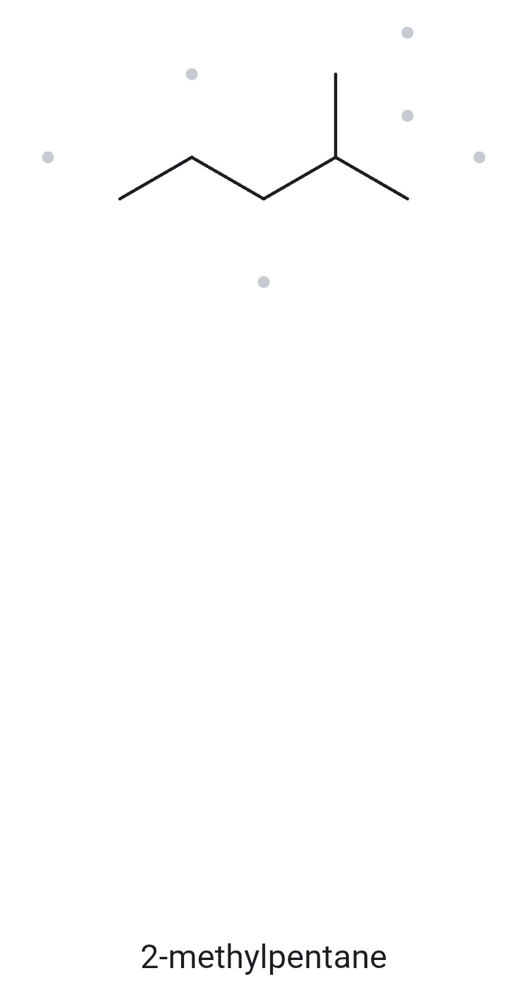
CARD A01 — STRUCTURE → NAME
Level: FOUNDATION Molecular formula (counted): C₆H₁₄
1. NUMBERED PARENT
2. NAMING TRAIL
Parent: longest chain = 5 C → pentane.
Numbering: left → right gives 4; right → left gives 2. The lower locant is 2, so number from the right.
Substituents: methyl on C2 → 2-methyl.
4
2
5
3
1
Parent (5 C) highlighted; carbons numbered from the end nearer the methyl branch.
3. MY NAME (WRITTEN FIRST)
4. THE ALKANE CHECK
✓ matched -The names I typed agree with the names returned by The Alkane, confirming that the structures and IUPAC naming rules were applied consistently.
2-methylpentane
V E R I F I C A T I O N S T R I P
✓
✓
✓
✓
✓
☐ longest chain/ring ☐ lowest locants ☐ alphabetical order ☐ punctuation ☐ formula counted
Bicol University · College of Engineering · Department of Chemical Engineering
CHEM 13 · NAME IT, DRAW IT

Slide 2
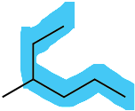
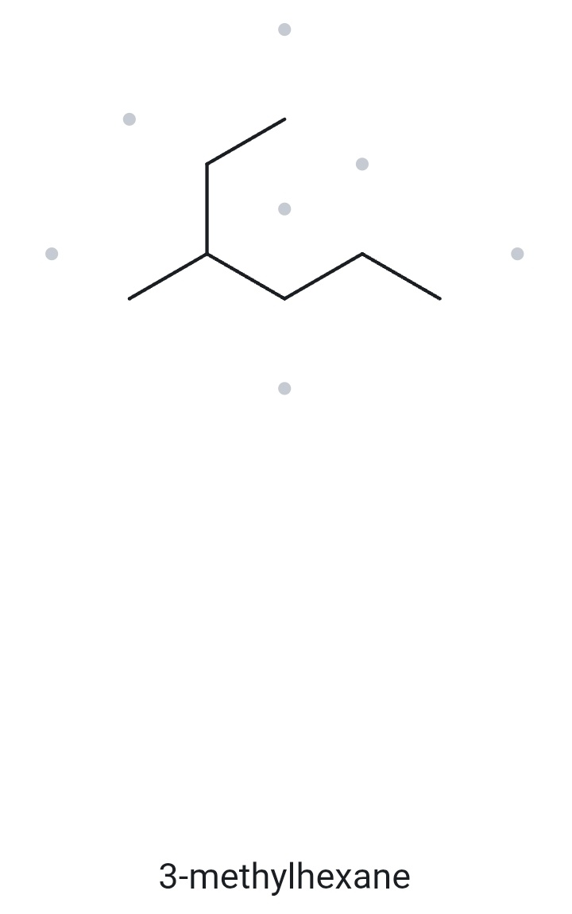
CARD A02 — STRUCTURE → NAME
Level: FOUNDATION Molecular formula (counted): C₇H₁₆
1. NUMBERED PARENT
2. NAMING TRAIL
1
2
Parent: longest chain = 6 C → hexane..
Numbering: one direction gives methyl on C4; the opposite direction gives methyl on C3. The lower locant is 3.
Substituents: methyl on C3 → 3-methyl.
3
5
4
6
Parent (6 C) highlighted; the parent chain follows the upper branch through the central junction and toward the right-hand end.
3-methylhexane
3. MY NAME (WRITTEN FIRST)
4. THE ALKANE CHECK
✓ matched -The names I typed agree with the names returned by The Alkane, confirming that the structures and IUPAC naming rules were applied consistently.
V E R I F I C A T I O N S T R I P
✓
✓
✓
✓
✓
☐ longest chain/ring ☐ lowest locants ☐ alphabetical order ☐ punctuation ☐ formula counted
Bicol University · College of Engineering · Department of Chemical Engineering
CHEM 13 · NAME IT, DRAW IT

Slide 3
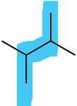
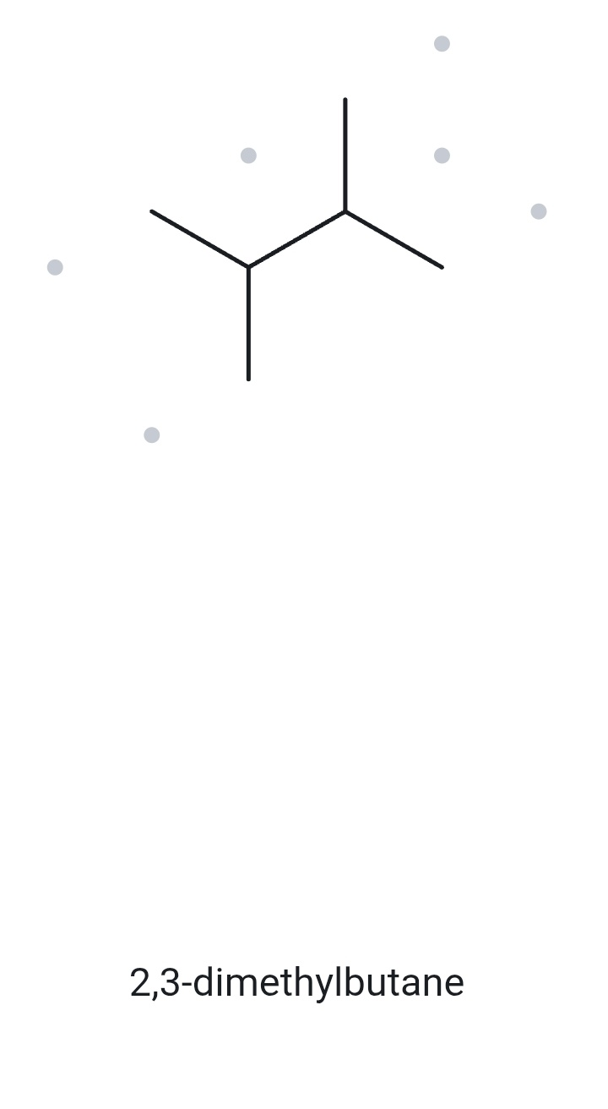
CARD A03 — STRUCTURE → NAME
Level: FOUNDATION Molecular formula (counted): C₆H₁₄
4
1. NUMBERED PARENT
2. NAMING TRAIL
3
Parent: longest chain = 4 C → butane.
Numbering: left → right gives 2,3; right → left also gives 2,3. Both directions produce the same locants.
Substituents: methyl on C2 and C3 → 2,3-dimethyl.
2
1
Parent (4 C) highlighted; carbons numbered from either end because the structure is symmetrical.
2,3-dimethylbutane
3. MY NAME (WRITTEN FIRST)
4. THE ALKANE CHECK
✓ matched -The names I typed agree with the names returned by The Alkane, confirming that the structures and IUPAC naming rules were applied consistently.
V E R I F I C A T I O N S T R I P
✓
✓
✓
✓
✓
☐ longest chain/ring ☐ lowest locants ☐ alphabetical order ☐ punctuation ☐ formula counted
Bicol University · College of Engineering · Department of Chemical Engineering
CHEM 13 · NAME IT, DRAW IT

Slide 4
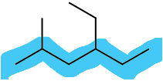
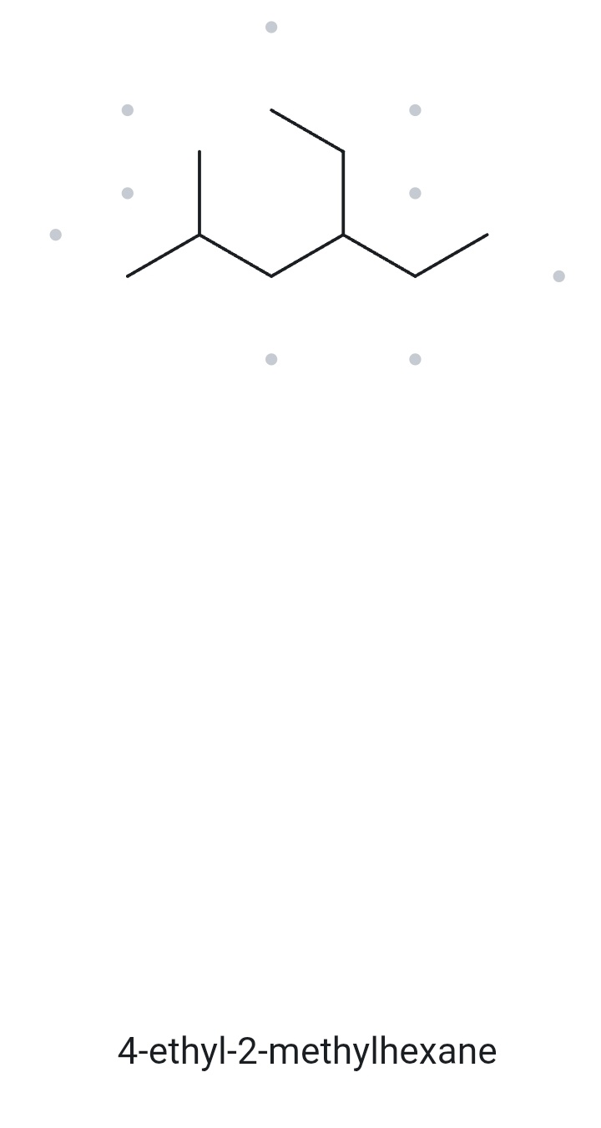
CARD A04 — STRUCTURE → NAME
Level: DEVELOPING Molecular formula (counted): C₉H₂₀
1. NUMBERED PARENT
2. NAMING TRAIL
6
Parent: longest chain = 6 C → hexane.
Numbering: left → right gives 2,4; right → left gives 3,5. The first point of difference is 2 versus 3, so number from the left.
Substituents: ethyl on C4 and methyl on C2. Alphabetically, ethyl comes before methyl → 4-ethyl-2-methyl.
1
2
4
3
5
Parent (6 C) highlighted; carbons numbered from the left-hand end to obtain the lower set of locants.
4-ethyl-2-methylhexane
3. MY NAME (WRITTEN FIRST)
4. THE ALKANE CHECK
✓ matched -The names I typed agree with the names returned by The Alkane, confirming that the structures and IUPAC naming rules were applied consistently.
V E R I F I C A T I O N S T R I P
✓
✓
✓
✓
✓
☐ longest chain/ring ☐ lowest locants ☐ alphabetical order ☐ punctuation ☐ formula counted
Bicol University · College of Engineering · Department of Chemical Engineering
CHEM 13 · NAME IT, DRAW IT

Slide 5

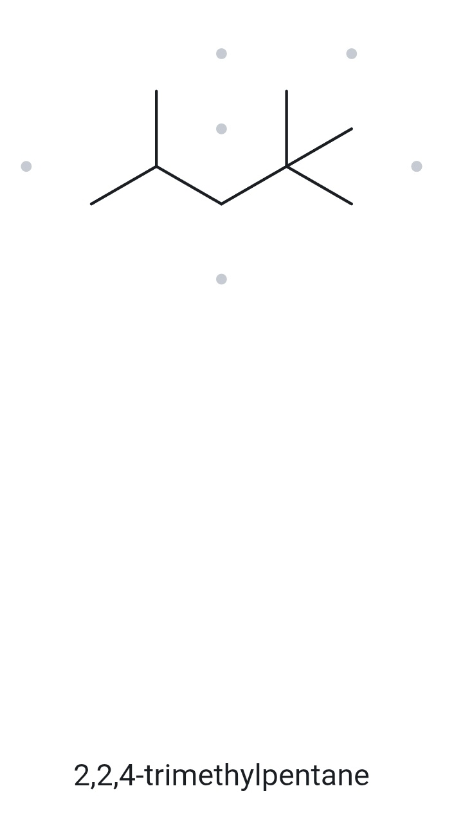
CARD A05 — STRUCTURE → NAME
Level: DEVELOPING Molecular formula (counted): C₈H₁₈
1. NUMBERED PARENT
2. NAMING TRAIL
Parent: longest chain = 5 C → pentane.
Numbering: left → right gives 2,4,4; right → left gives 2,2,4. The first point of difference is 2 versus 4, so number from the right.
Substituents: methyl on C2, C2 and C4 → 2,2,4-trimethyl.
4
2
1
5
3
Parent (5 C) highlighted; carbons numbered from the right-hand end to give the lowest locants.
2,2,4-trimethylpentane
3. MY NAME (WRITTEN FIRST)
4. THE ALKANE CHECK
✓ matched -The names I typed agree with the names returned by The Alkane, confirming that the structures and IUPAC naming rules were applied consistently.
V E R I F I C A T I O N S T R I P
✓
✓
✓
✓
✓
☐ longest chain/ring ☐ lowest locants ☐ alphabetical order ☐ punctuation ☐ formula counted
Bicol University · College of Engineering · Department of Chemical Engineering
CHEM 13 · NAME IT, DRAW IT

Slide 6
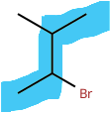
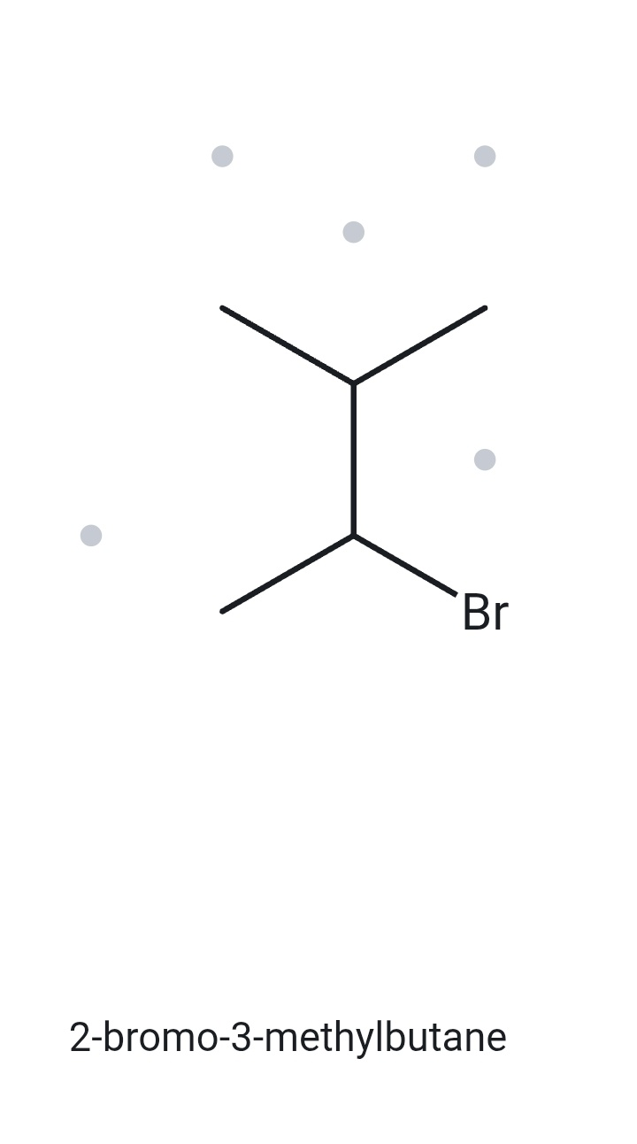
CARD A06 — STRUCTURE → NAME
Level: DEVELOPING Molecular formula (counted): C₅H₁₁Br
1. NUMBERED PARENT
2. NAMING TRAIL
4
3
Parent: longest chain = 4 C → butane.
Numbering: both directions give the locant set 2,3. Since the sets tie, the substituent cited first alphabetically receives the lower number.
Substituents: bromo on C2 and methyl on C3 → 2-bromo-3-methyl.
2
1
Parent (4 C) highlighted; carbons numbered from the end that gives bromo the lower locant in the tie.
2-bromo-3-methylbutane
3. MY NAME (WRITTEN FIRST)
4. THE ALKANE CHECK
✓ matched -The names I typed agree with the names returned by The Alkane, confirming that the structures and IUPAC naming rules were applied consistently.
V E R I F I C A T I O N S T R I P
✓
✓
✓
✓
✓
☐ longest chain/ring ☐ lowest locants ☐ alphabetical order ☐ punctuation ☐ formula counted
Bicol University · College of Engineering · Department of Chemical Engineering
CHEM 13 · NAME IT, DRAW IT

Slide 7

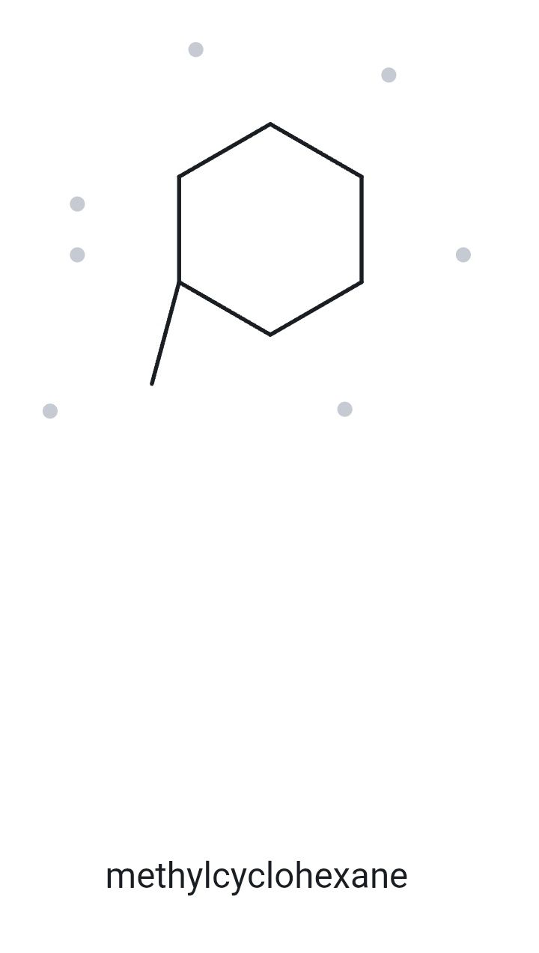
CARD A07 — STRUCTURE → NAME
Level: DEVELOPING Molecular formula (counted): C₇H₁₄
1. NUMBERED PARENT
2. NAMING TRAIL
5
6
4
Parent: ring has 6 C → cyclohexane.
Numbering: only one substituent is present, so no locant is required.
Substituents: methyl attached to the ring → methylcyclohexane.
1
3
2
Parent (6 C) highlighted as a cyclohexane ring; the attached methyl group is on C1. Numbering is unnecessary for a ring with only one substituent.
methylcyclohexane
3. MY NAME (WRITTEN FIRST)
4. THE ALKANE CHECK
✓ matched -The names I typed agree with the names returned by The Alkane, confirming that the structures and IUPAC naming rules were applied consistently.
V E R I F I C A T I O N S T R I P
✓
✓
✓
✓
✓
☐ longest chain/ring ☐ lowest locants ☐ alphabetical order ☐ punctuation ☐ formula counted
Bicol University · College of Engineering · Department of Chemical Engineering
CHEM 13 · NAME IT, DRAW IT

Slide 8
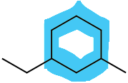
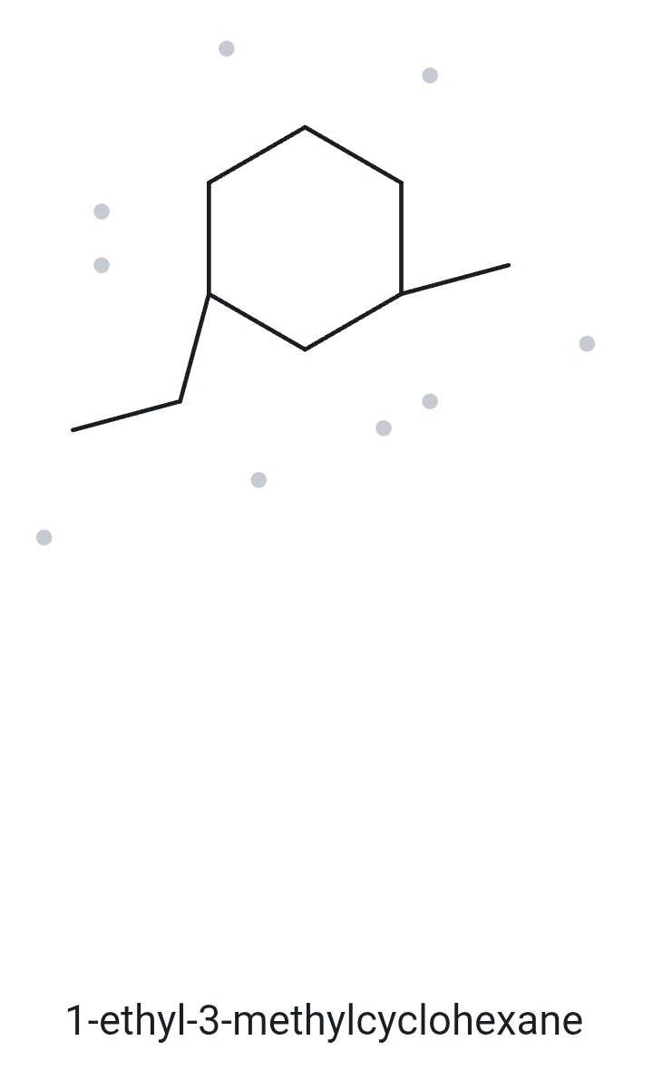
CARD A08 — STRUCTURE → NAME
Level: CHALLENGE Molecular formula (counted): C₉H₁₈
1. NUMBERED PARENT
2. NAMING TRAIL
5
6
4
Parent: ring has 6 C → cyclohexane.
Numbering: both directions give locants 1,3. Since the locant sets tie, ethyl receives C1 because it comes before methyl alphabetically.
Substituents: ethyl on C1 and methyl on C3 → 1-ethyl-3-methyl.
1
3
2
Parent (6 C) highlighted as a cyclohexane ring; numbering starts at the carbon attached to the ethyl group.
1-ethyl-3-methylcyclohexane
3. MY NAME (WRITTEN FIRST)
4. THE ALKANE CHECK
✓ matched -The names I typed agree with the names returned by The Alkane, confirming that the structures and IUPAC naming rules were applied consistently.
V E R I F I C A T I O N S T R I P
✓
✓
✓
✓
✓
☐ longest chain/ring ☐ lowest locants ☐ alphabetical order ☐ punctuation ☐ formula counted
Bicol University · College of Engineering · Department of Chemical Engineering
CHEM 13 · NAME IT, DRAW IT

Slide 9
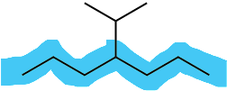
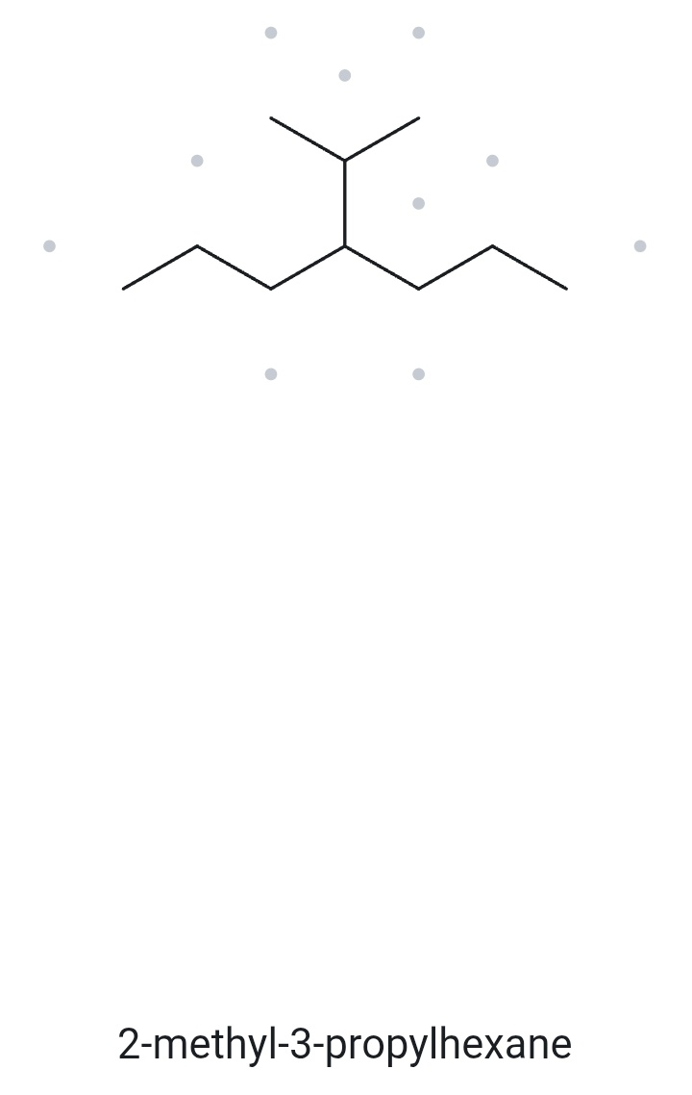
CARD A09 — STRUCTURE → NAME
Level: CHALLENGE Molecular formula (counted): C₁₀H₂₂
1. NUMBERED PARENT
2. NAMING TRAIL
Parent: longest chain = 7 C → heptane. The upper branch is not included entirely in the parent chain because the longest continuous chain contains 7 carbons.
Numbering: left → right gives 4; right → left also gives 4. Both directions produce the same locant.
Substituents: propan-2-yl (isopropyl) on C4.
1
2
3
4
5
6
7
Parent (7 C) highlighted; heptane chain selected as the longest continuous chain.
4-isopropylheptane
3. MY NAME (WRITTEN FIRST)
4. THE ALKANE CHECK
✗ mismatched - The Alkane selected a six-carbon parent chain (hexane), but I selected the longest continuous seven-carbon chain (heptane) as the parent, so the resulting IUPAC names are different.
V E R I F I C A T I O N S T R I P
✓
✓
✓
✓
✓
☐ longest chain/ring ☐ lowest locants ☐ alphabetical order ☐ punctuation ☐ formula counted
Bicol University · College of Engineering · Department of Chemical Engineering
CHEM 13 · NAME IT, DRAW IT

Slide 10

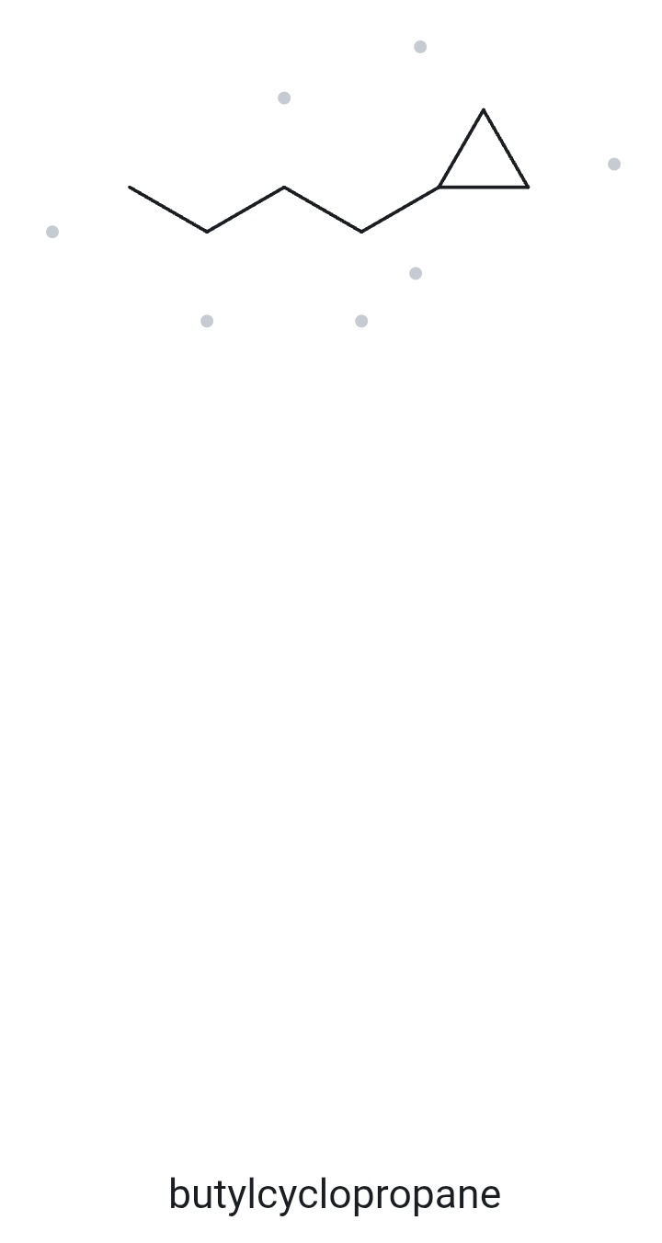
CARD A10 — STRUCTURE → NAME
Level: __________ Molecular formula (counted): __________
1. NUMBERED PARENT
2. NAMING TRAIL
4
Parent: longest chain = 4 C → butane. The open chain has more carbons than the cyclopropane ring.
Numbering: number from the end nearest the cyclopropyl substituent → substituent on C1.
Substituents: cyclopropyl on C1.
3
2
1
Parent (4 C) highlighted; butane chain selected because it has more carbons than the cyclopropane ring (3 C).
1-cyclopropylbutane
3. MY NAME (WRITTEN FIRST)
4. THE ALKANE CHECK
✗ mismatched - The Alkane selected the ring as the parent and named the open chain as a butyl substituent, while I selected the longer four-carbon open chain as the parent and named the ring as a cyclopropyl substituent.
V E R I F I C A T I O N S T R I P
✓
✓
✓
✓
✓
☐ longest chain/ring ☐ lowest locants ☐ alphabetical order ☐ punctuation ☐ formula counted
Bicol University · College of Engineering · Department of Chemical Engineering
CHEM 13 · NAME IT, DRAW IT

Slide 11
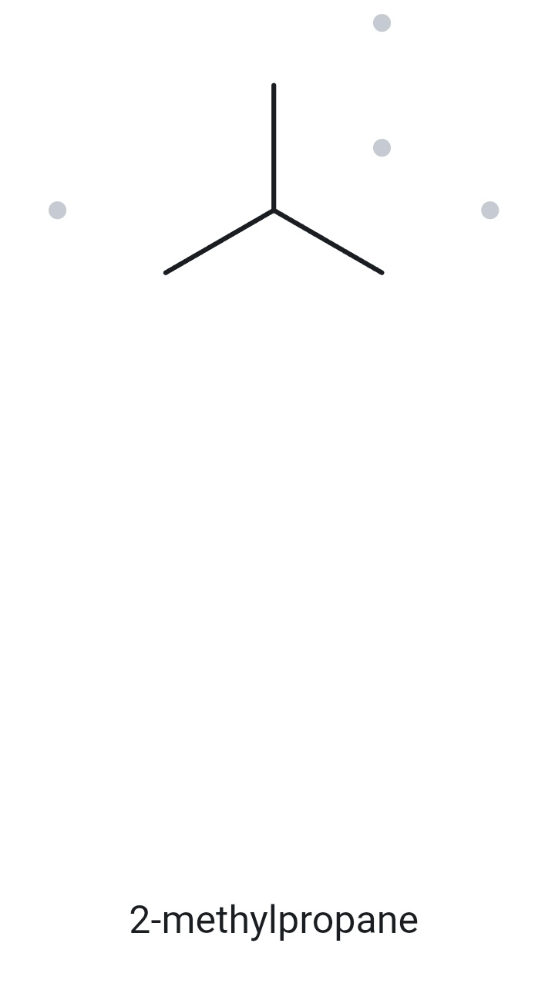

CARD B01 — NAME → STRUCTURE
Level: FOUNDATION Given name: 2-methylpropane
1. NAME DECODED
2. BOND-LINE STRUCTURE (THE ALKANE)
Parent: propane → 3 carbons
Substituents: methyl at C-2
Expected Formula: 3 + 1 = 4 C; open chain → C₄H₁₀.
3. FORMULA CHECK
Returned by The Alkane:
✓ Same as the given name
4. BACK-CHECK
Counted from the drawing: C₄H₁₀.
Open chain: CₙH₂ₙ₊₂ = C₄H₁₀ ✓
V E R I F I C A T I O N S T R I P
✓
☐ parent length ☐ substituent positions ☐ formula agrees ☐ back-check recorded
Bicol University · College of Engineering · Department of Chemical Engineering
CHEM 13 · NAME IT, DRAW IT

Slide 12
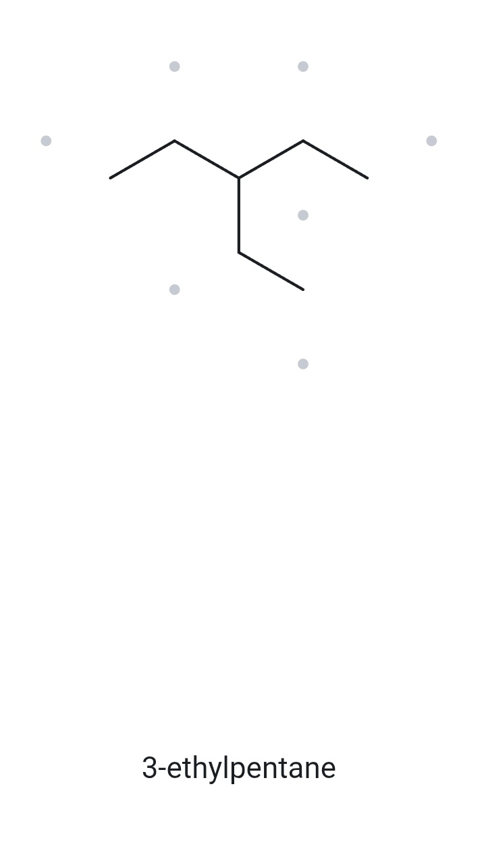
CARD B02 — NAME → STRUCTURE
Level: FOUNDATION Given name: 3-ethylpentane
1. NAME DECODED
2. BOND-LINE STRUCTURE (THE ALKANE)
Parent: pentane → 5-carbon chain
Substituents: ethyl on C3
Expected Formula: 5 + 2 = 7 C; open chain → C₇H₁₆
3. FORMULA CHECK
4. BACK-CHECK
Returned by The Alkane:
✓ Same as the given name
Counted from the drawing: C₇H₁₆
Open chain: CₙH₂ₙ₊₂ = C₇H₁₆ ✓
V E R I F I C A T I O N S T R I P
✓
☐ parent length ☐ substituent positions ☐ formula agrees ☐ back-check recorded
Bicol University · College of Engineering · Department of Chemical Engineering
CHEM 13 · NAME IT, DRAW IT

Slide 13
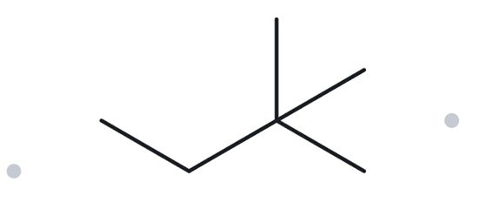

CARD B03 — NAME → STRUCTURE
Level: FOUNDATION Given name: 2,2-dimethylbutane
1. NAME DECODED
2. BOND-LINE STRUCTURE (THE ALKANE)
Parent: butane → 4-carbon chain.
Substituents: two methyl groups on C2
Expected Formula: 4 + 2 = 6 C; open chain → C₆H₁₄
3. FORMULA CHECK
4. BACK-CHECK
Returned by The Alkane:
✓ Same as the given name
Counted from the drawing: C₆H₁₄
Open chain: CₙH₂ₙ₊₂ = C₆H₁₄ ✓
V E R I F I C A T I O N S T R I P
✓
☐ parent length ☐ substituent positions ☐ formula agrees ☐ back-check recorded
Bicol University · College of Engineering · Department of Chemical Engineering
CHEM 13 · NAME IT, DRAW IT

Slide 14
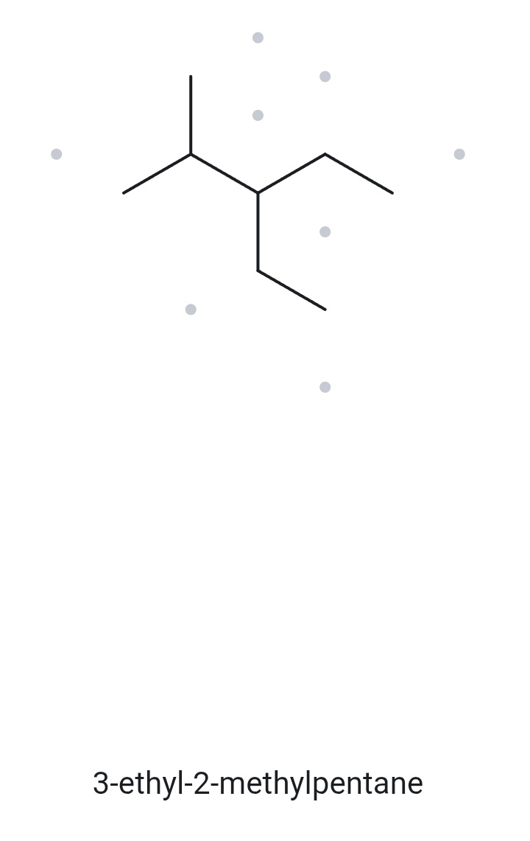
CARD B04 — NAME → STRUCTURE
Level: DEVELOPING Given name: 3-ethyl-2-methylpentane
1. NAME DECODED
2. BOND-LINE STRUCTURE (THE ALKANE)
Parent: pentane → 5-carbon chain
Substituents: ethyl on C3; methyl on C2
Expected Formula: 5 + 2 + 1 = 8 C; open chain → C₈H₁₈
3. FORMULA CHECK
4. BACK-CHECK
Returned by The Alkane:
✓ Same as the given name
Counted from the drawing: C₈H₁₈
Open chain: CₙH₂ₙ₊₂ = C₈H₁₈ ✓
V E R I F I C A T I O N S T R I P
✓
☐ parent length ☐ substituent positions ☐ formula agrees ☐ back-check recorded
Bicol University · College of Engineering · Department of Chemical Engineering
CHEM 13 · NAME IT, DRAW IT

Slide 15
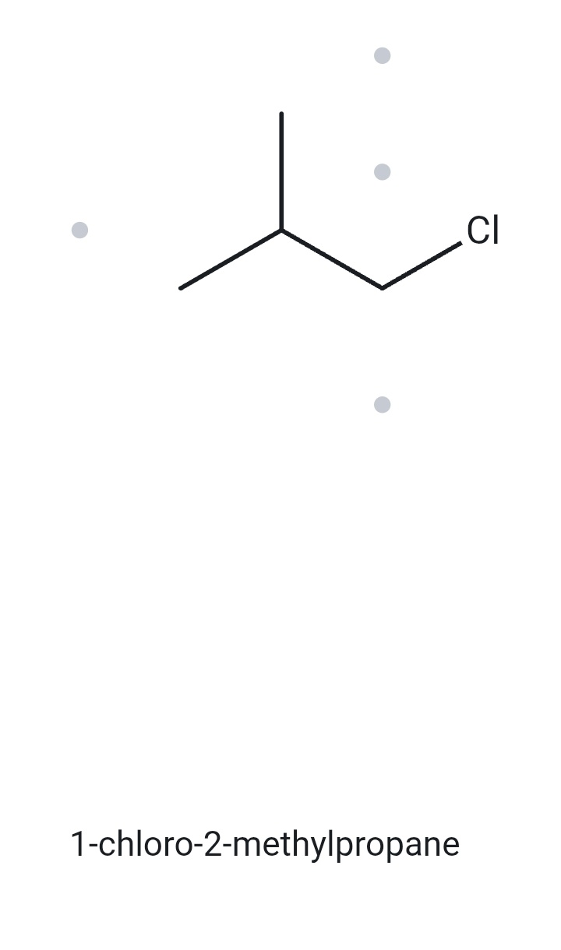
CARD B05 — NAME → STRUCTURE
Level: DEVELOPING Given name: 1-chloro-2-methylpropane
1. NAME DECODED
2. BOND-LINE STRUCTURE (THE ALKANE)
Parent: propane → 3 carbons
Substituents: chloro on C1; methyl on C2
Expected Formula: 3 + 1 = 4 C; open chain → C₄H₁₀;
Cl replaces one H → C₄H₉Cl
3. FORMULA CHECK
4. BACK-CHECK
Returned by The Alkane:
✓ Same as the given name
Counted from the drawing: C₄H₉Cl
Open chain: CₙH₂ₙ₊₂ = C₄H₁₀; minus one H for Cl = C₄H₉Cl ✓
V E R I F I C A T I O N S T R I P
✓
☐ parent length ☐ substituent positions ☐ formula agrees ☐ back-check recorded
Bicol University · College of Engineering · Department of Chemical Engineering
CHEM 13 · NAME IT, DRAW IT

Slide 16
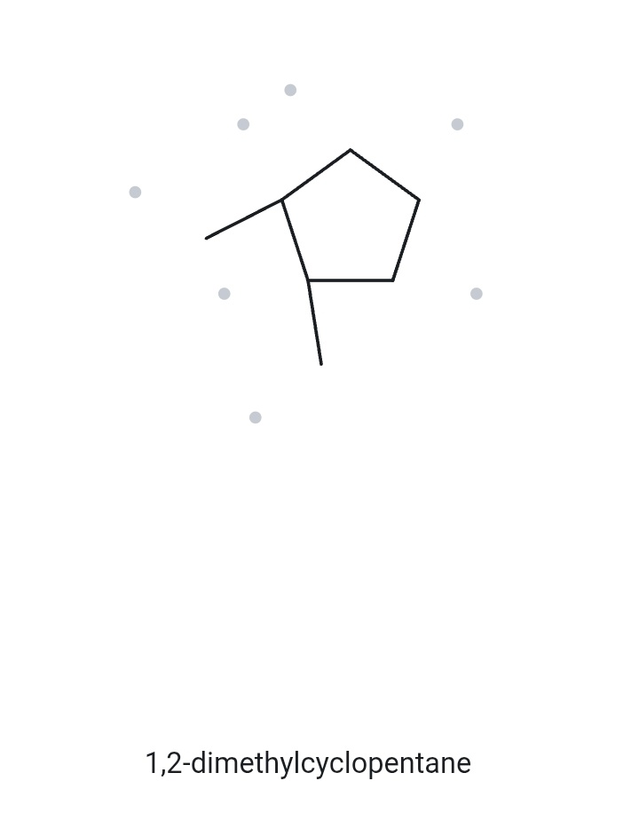
CARD B06 — NAME → STRUCTURE
Level: DEVELOPING Given name: 1,2-dimethylcyclopentane
1. NAME DECODED
2. BOND-LINE STRUCTURE (THE ALKANE)
Parent: cyclopentane → a 5-carbon ring
Substituents: methyl on C1 and C2
Expected Formula: 5 + 1 + 1 = 7 C; one ring → C₇H₁₄
3. FORMULA CHECK
4. BACK-CHECK
Returned by The Alkane:
✓ Same as the given name
Counted from the drawing: C₇H₁₄
Open chain: CₙH₂ₙ = C₇H₁₄ ✓
V E R I F I C A T I O N S T R I P
✓
☐ parent length ☐ substituent positions ☐ formula agrees ☐ back-check recorded
Bicol University · College of Engineering · Department of Chemical Engineering
CHEM 13 · NAME IT, DRAW IT

Slide 17
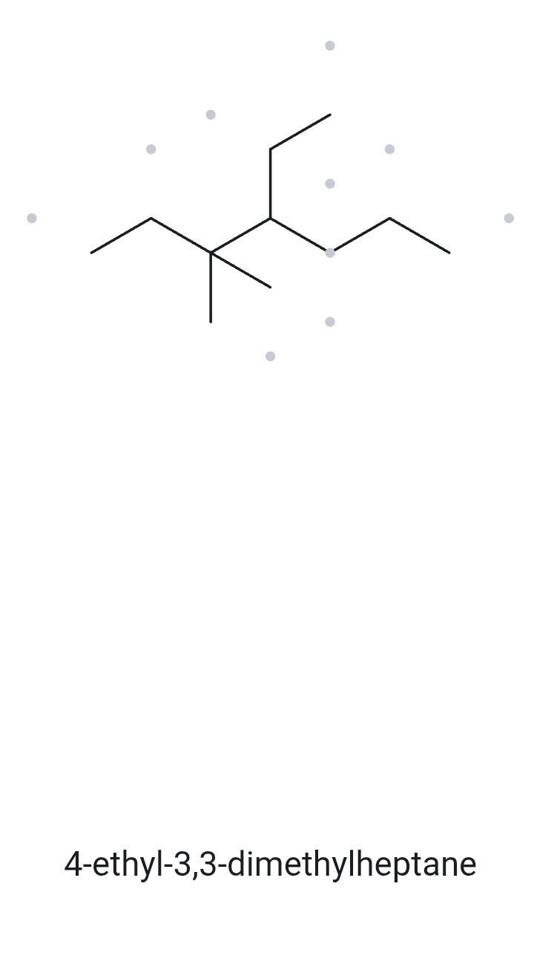
CARD B07 — NAME → STRUCTURE
Level: DEVELOPING Given name: 4-ethyl-3,3-dimethylheptane
1. NAME DECODED
2. BOND-LINE STRUCTURE (THE ALKANE)
Parent: heptane → 7-carbon chain
Substituents: ethyl on C4; two methyl groups on C3
Expected Formula: 7 + 2 + 1 + 1 = 11 C; open chain → C₁₁H₂₄
3. FORMULA CHECK
4. BACK-CHECK
Returned by The Alkane:
✓ Same as the given name
Counted from the drawing: C₁₁H₂₄
Open chain: CₙH₂ₙ₊₂ = C₁₁H₂₄ ✓
V E R I F I C A T I O N S T R I P
✓
☐ parent length ☐ substituent positions ☐ formula agrees ☐ back-check recorded
Bicol University · College of Engineering · Department of Chemical Engineering
CHEM 13 · NAME IT, DRAW IT

Slide 18
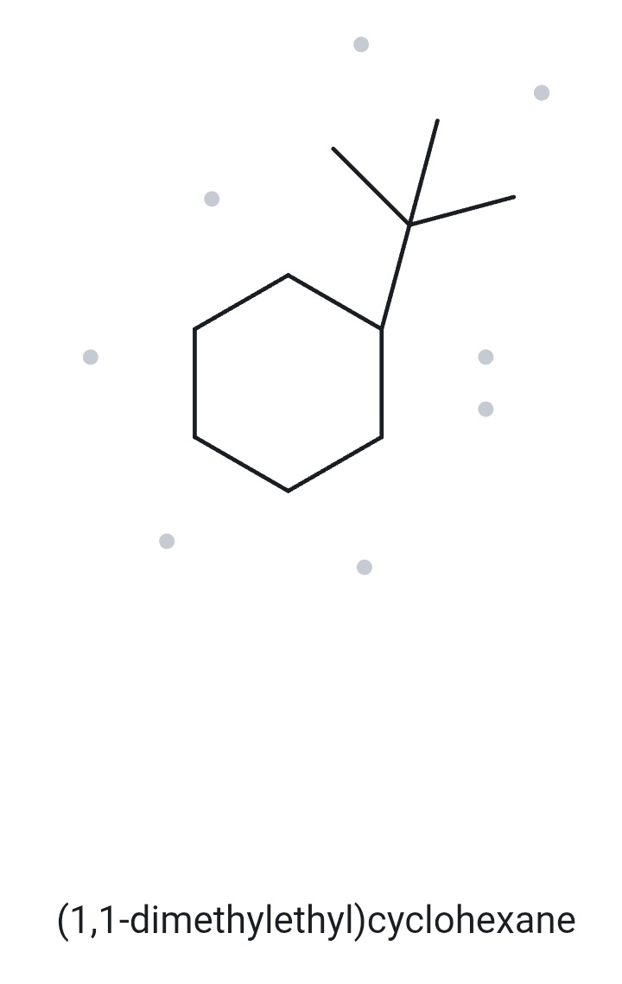
CARD B08 — NAME → STRUCTURE
Level: CHALLENGE Given name: tert-butylcyclohexane
1. NAME DECODED
2. BOND-LINE STRUCTURE (THE ALKANE)
Parent: cyclohexane → 6-carbon ring
Substituents: tert-butyl on C1; the substituent contains 4 carbons
Expected Formula: 6 + 4 = 10 C; one ring → C₁₀H₂₀
3. FORMULA CHECK
4. BACK-CHECK
Returned by The Alkane:
✓ Same as the given name
(tert-butyl and 1,1-dimethylethyl are equivalent names for the same substituent.)
Counted from the drawing: C₁₀H₂₀
Open chain: CₙH₂ₙ = C₁₀H₂₀ ✓
V E R I F I C A T I O N S T R I P
✓
☐ parent length ☐ substituent positions ☐ formula agrees ☐ back-check recorded
Bicol University · College of Engineering · Department of Chemical Engineering
CHEM 13 · NAME IT, DRAW IT

Slide 19
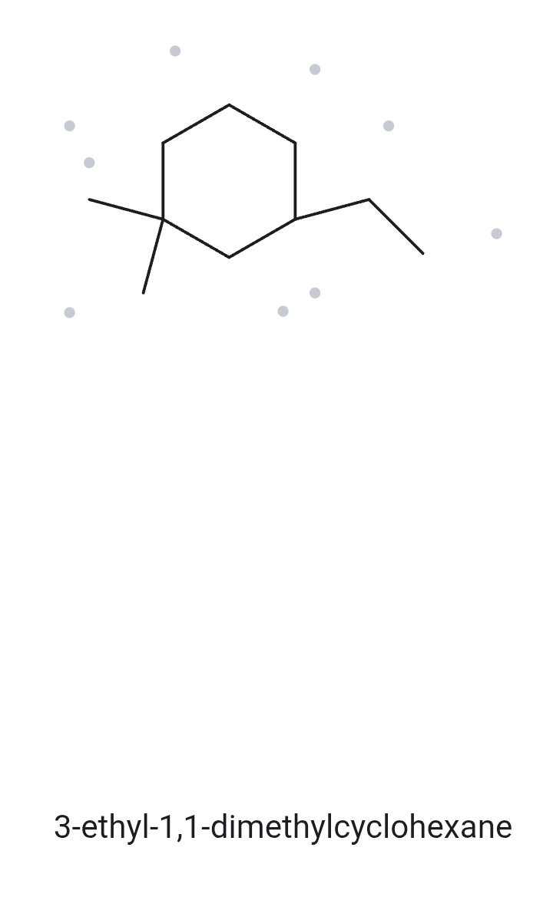
CARD B09 — NAME → STRUCTURE
Level: CHALLENGE Given name: 3-ethyl-1,1-dimethylcyclohexane
1. NAME DECODED
2. BOND-LINE STRUCTURE (THE ALKANE)
Parent: cyclohexane → 6-carbon ring
Substituents: two methyl groups on C1; ethyl on C3
Expected Formula: 6 + 1 + 1 + 2 = 10 C; one ring → C₁₀H₂₀
3. FORMULA CHECK
4. BACK-CHECK
Returned by The Alkane:
✓ Same as the given name
Counted from the drawing: C₁₀H₂₀
Open chain: CₙH₂ₙ = C₁₀H₂₀ ✓
V E R I F I C A T I O N S T R I P
✓
☐ parent length ☐ substituent positions ☐ formula agrees ☐ back-check recorded
Bicol University · College of Engineering · Department of Chemical Engineering
CHEM 13 · NAME IT, DRAW IT

Slide 20
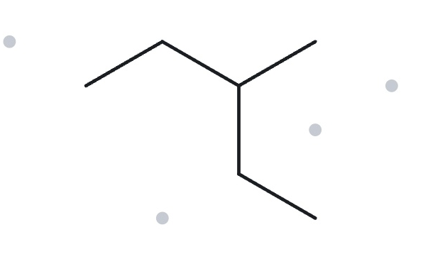

CARD B10 — NAME → STRUCTURE
Level: CHALLENGE Given name: 2-ethylbutane (deliberately incorrect name)
1. NAME DECODED
2. BOND-LINE STRUCTURE (THE ALKANE)
Parent: butane → a 4-carbon chain
Substituents: ethyl on C2
Expected Formula: 4 + 2 = 6 C; open chain → C₆H₁₄
3. FORMULA CHECK
4. BACK-CHECK
Returned by The Alkane:
Correct name: 3-methylpentane
Reason: The longest continuous chain contains 5 carbon atoms, so pentane must be selected as the parent instead of butane
Counted from the drawing: C₆H₁₄
Open chain: CₙH₂ₙ₊₂ = C₆H₁₄ ✓
V E R I F I C A T I O N S T R I P
✓
☐ parent length ☐ substituent positions ☐ formula agrees ☐ back-check recorded
Bicol University · College of Engineering · Department of Chemical Engineering
CHEM 13 · NAME IT, DRAW IT

